Slide 1
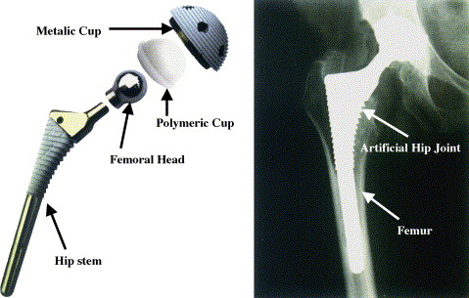
Ti-6Al-7Nb
Hip Prosthesis
(Femoral Hip Stem)
Derryl Poynor
Rick Steffe
David Cunningham
Notes:
Introduction: Time, use, and accidents can wear on our bodies until they no longer function. Then what do you do? Using their vast knowledge of metals, properties, and manufacturing, engineers and metallurgists have recreated some of these structures that are compatible to work within our body. A very common problem in older people is worn hips. We use our hips all of the time even when we are lying down. One of the structures created is a hip replacement, or more specifically the femoral component of a hip prosthesis. It is made of the alloy Ti-6Al-7Nb.
Explain the picture of the hip prosthesis and compare the two pictures

Slide 2
Composition
Impurities
Ta: < 0.5%
Fe: < 0.25%
N2: < 0.05%
O2: < 0.2%
C: < 0.08%
H2: < 0.009%
Notes:
Explain how Ti-6Al-7Nb explains its percentage of alloys and why each elements purpose is
Titanium is biocompatible, corrosion resistance, low density, and a similar elastic modulus to bone
Aluminum is an alpha stabilizer
Niobium is a beta stabilizer and more compatible than vanadium. (Explain that Ti-6Al-4V is also used)
State the impurities
Impurities
Causes alloy to assimilate undesirable properties
Fit into the gaps between larger molecules
Comes from air and molds
Ta: < 0.5%
Fe: < 0.25%
N₂: < 0.05%
O₂: < 0.2%
Lowers fracture toughness
Has a very high affinity for titanium
C: < 0.08%
Reduces ductility
Increases overall strength
H₂: < 0.009%
Explain how the impurities do not physically affect the molecular structure (refer to drawing), but instead give the alloy the properties

Slide 4
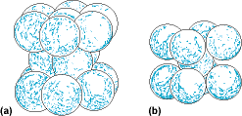
Chemical Properties
Superior Atmospheric Corrosion
Allotropic
Highly Reactive Metal Surface
BIOCOMPATIBLE!
Cells accept alloy
High protein absorption
Inert coating
Notes:
Atmospheric Corrosion- prevents from being deteriorated from elements, such as oxygen.
Allotropic- Explain what that is (Alpha-beta alloy that transitions to beta at 1850oF)
Explain the molecular structure of both (refer to picture)
Highly reactive Metal Surface – Naturally bonds with oxygen to form an inert coating (helps with biocompatibility)
Biocompatible- (Explain during next slide)

Slide 5
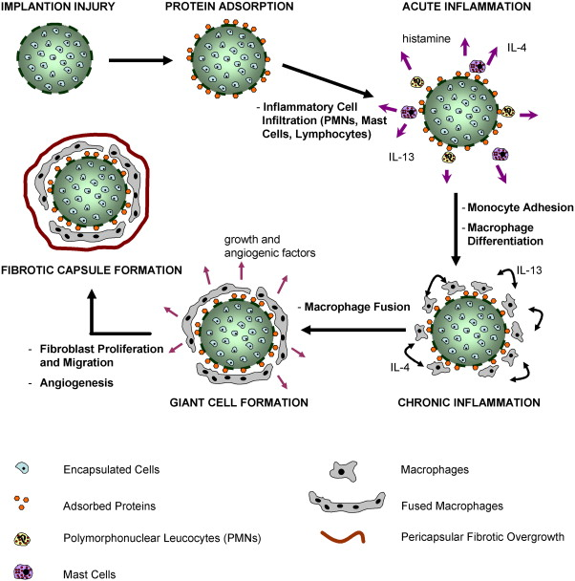
http://ars.els-cdn.com/content/image/1-s2.0-S0169409X10000402-gr2.jpg
Notes:
Biocompatibility means high protein absorption, inert surface, and cells accept the alloy.
The protein must absorb proteins in order to fool the immune system that the hip prosthesis is “SELF” (implant needs a porous surface)
Inert surfaces means that the implant won’t release toxins into the body or react with other elements
Cells accept the alloy means that the immune system wont attack the implant, causing inflammation and rejection.
Explain the picture

Slide 6
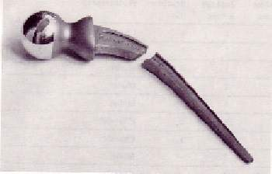
Stress/Strain
Tensile strength is 145ksi
Hardness values
Rockwell A – 66.5
Rockwell C – 32
High compressive strength is 156-158 ksi
Elongation is 9.4 – 13.2%
Fracture toughness is 61.9 – 68.3 ksi. in^{1/2}
Fatigue Strength is 72500 psi
Yield Strength is 114 – 130 ksi
Notes:
Tensile strength is 145ksi
Hardness values
Rockwell A – 66.5
Rockwell C – 32
Rockwell D – 49.0
High compressive strength (156-158 ksi)
Must withstand weight and movement of recipient
Elongation (9.4 – 13.2%)
Only matters if you jump off of a building
Fracture toughness
61.9 – 68.3 ksi. in^{1/2}
Resists cracks from getting worse
Isn’t as high as it ideally should be
Fatigue Strength
72500 psi (10 Million Cycles, Rotating bend motion)
Lasts a long time (10 year guarantee)
Can handle pressure from being applied and released continually
Yield Strength (114 – 130 ksi)

Slide 7
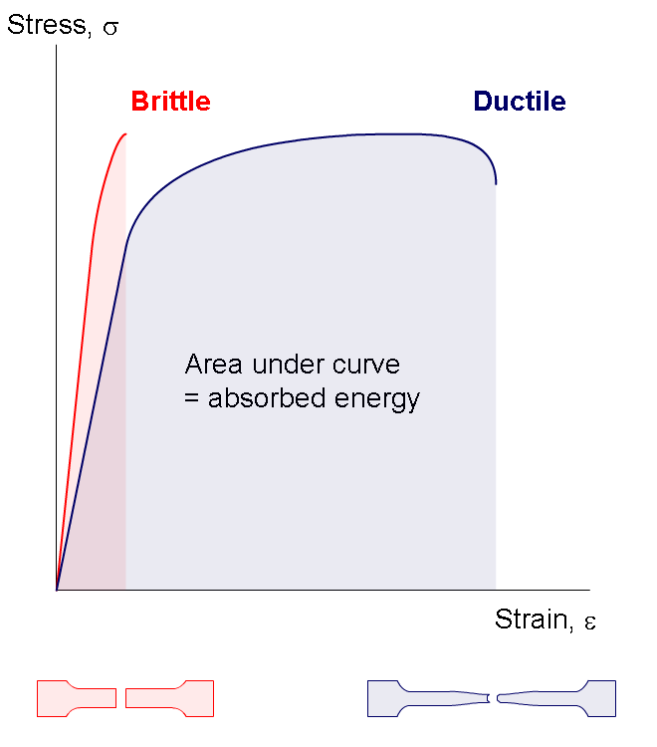
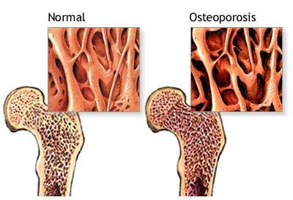
Physical Properties
Ductile
Low density
Low friction
Notes:
Mechanical & Physical Properties
½ Density of steel
Density is 4.52g/cm³
Lightweight like a bone
Still weigh denser than a bone however
Low friction
Less wear
More range of motion
Use Natural lubrication
Ductile
Like elongation, only matters if you jumped off of a building

Slide 8
Manufacturing: Forging
Isothermal Forging
Cut ingot
Heat ingot to 900º^{C}
Fed into a hydraulic press
Heat treat
Annealed
700ºC for 1 hour
Air cooled
Notes:
Isothermal Forging
Closed dye forging with equal temperature throughout process
Cut an ingot to a precise length
Heated to about 900º^{C}
Die inserts (usually nickel) are heated to the forging temperature
Fed into hydraulic press with a specific tool to form
Have net shape
Accurate precision
Heat Treat of Isothermal Forging
Annealed
Temperature: 700º^{C} for 1 hour
Air cooled, which allows for less deformation

Slide 9
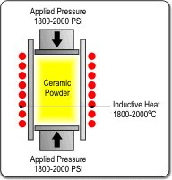
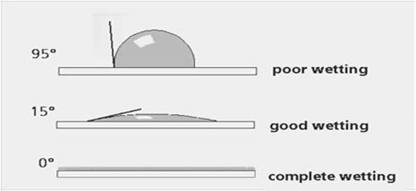
Manufacturing: Hot Press
Hot-pressing in molds
Loose powder placed into mold
Heat and pressure are applied
Occurs in a vacuum
Chemical/Heat Treat
Product is grit blasted
Passivation in nitric acid
Placed in an alkaline solution
Heat treated
In air or vacuum
At 600º^{C}
Notes:
Hot-pressing in molds
Loose powder placed into mold
Powder uses 90% of raw material
Can avoid/limit machining
Used for materials with high melting point
Hotter pressing temperature causes higher relative density
Hotter pressing temperature causes higher hardness
Occurs in a vacuum
Chemical/Heat Treat after Hot-pressing
Improves biocompatibility
Reduces metal ion release
Reduces water contact angle (increases wettability)
Helps to absorb body fluids (containing proteins)
Makes surface abrasive
For plasma coating
Passivation in nitric acid to remove any pathogens/diseases
Placed in an alkaline solution to form oxide coating (termed anodize)
Heat treated
In air or vacuum
At 600º^{C}

Slide 10
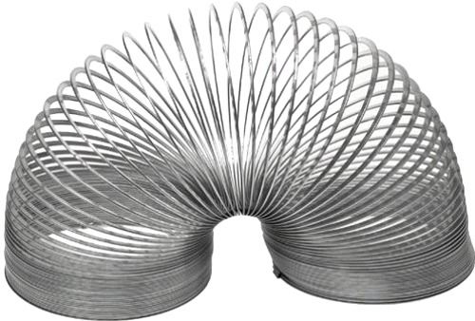
Other Information
Laser forming
Over 200 tons of semi-finished bars created
Other applications
Orthopedics
Dentistry
Slinkys
Airplane engines (I.E. fan blades)
Notes:
Recent experiment performed in 2012. Using a fine powder of Titanium Aluminum and Niobium. This is then inserted into a mold of the hip prosthesis and laser formed, over and over again till completed. This allows for a higher micron structure which in turn leads to less possibility of fractures or problems. This alloy is also used for knee, wrist and shoulder implants. Over 200 tons of semi-finished bars have been
http://www.jimrigby.org/wp-content/uploads/2012/03/slinky.jpg
created for mainly medical purposes of replacing parts in our bodies.

Slide 11
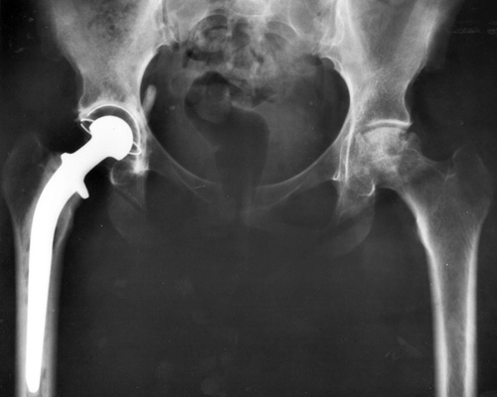
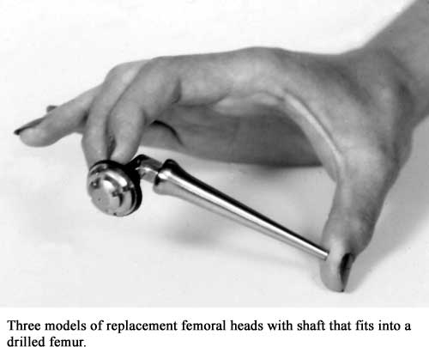
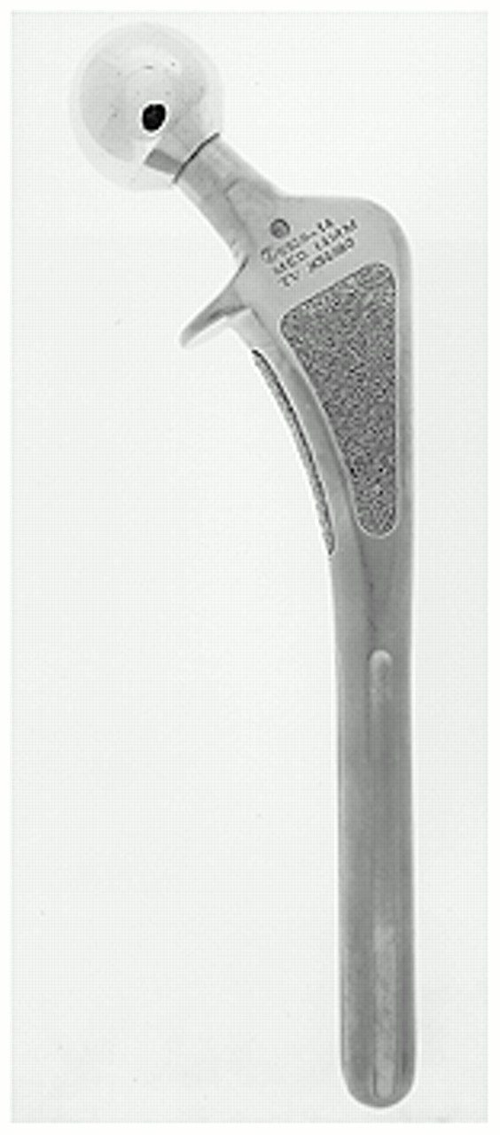
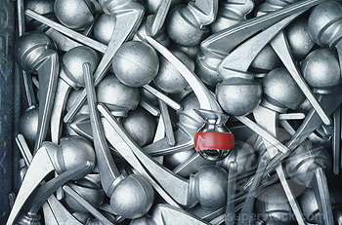
Notes:
Conclusion:
These are some of the applications of our alloy Ti-6Al-7Nb but the major one is the one in the middle for our particular research. If you think of all the ways we use our legs and hips each day it is perplexing how much wear and tear your body can take. One hundred years ago if your hip failed on you, you were a cripple possibly in a wheel chair. Now we have the ability to recreate your hip and you still have full control over it. We all take for granted our legs and how we can move whenever we want. This is why hip replacement is so amazing: it keeps people mobile so they can keep doing what they love.

